Slide 1
Scale Invariant Feature Transform (SIFT)
Dr. Partha Pratim Das
Department of Computer Science and Engineering of
Indian Institute of Technology, Kharagpur
AI Shack: SIFT: Theory and Practice:
http://www.aishack.in/tutorials/sift-scale-invariant-feature-transform-introduction/
Scale Invariant Feature Transform by Ajit Rajwade. CS 6350 – COMPUTER VISION, IIT Madras
SIFT Detector & Descriptor by Mubarak Shah. CAP 5415 – Computer Vision http://crcv.ucf.edu/courses/CAP5415/Fall2014/index.php
Notes:
Source: Image Compression (Chapter 8) H.R. Pourreza

Slide 2
Salient Characteristics - Desirable
Invariance of
Translation
Scaling or size
Rotation
View
Illumination
Scene Noise – Occlusion, Clutter, …
Deformation
Natural Variations
Computational Efficiency
Wide Range of Applications
Multi-view matching
Object recognition
Object category classification
Robotics

Slide 3
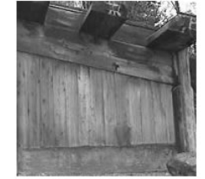
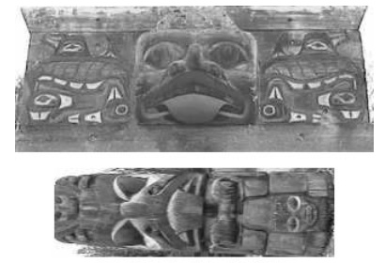
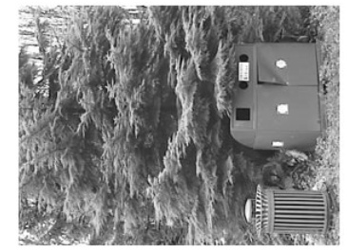
SIFT
Locating these objects

Slide 4
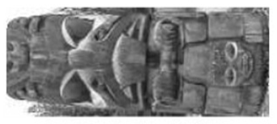
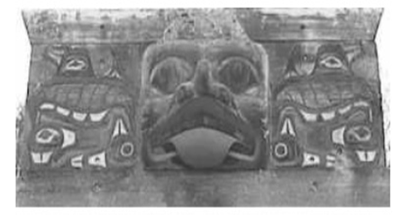
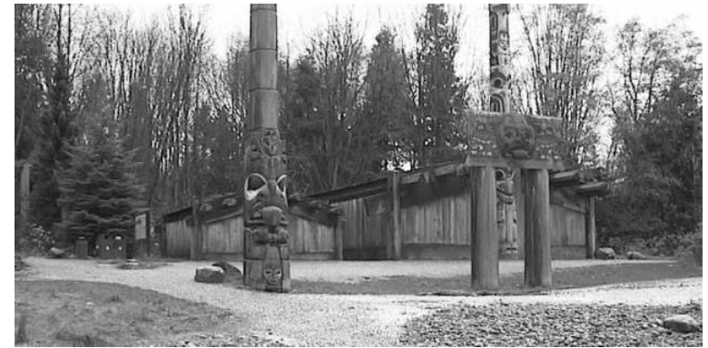
SIFT
In this scene using SIFT

Slide 5
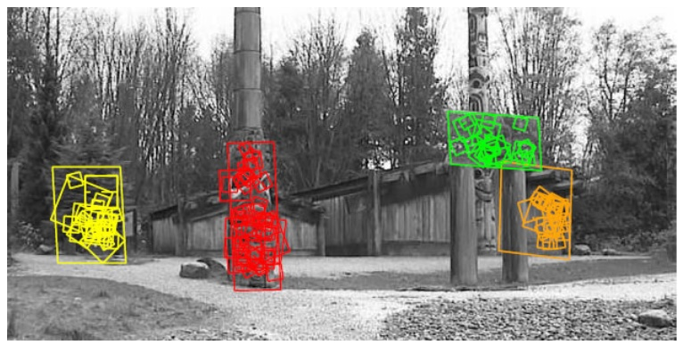
SIFT
Yields

Slide 6

SIFT: David Lowe, UBC
David G. Lowe is a Canadian computer scientist working for Google as a Senior Research Scientist.
He was a former professor in the Computer Science Department at the University of British Columbia and New York University.
He did his PhD from Stanford University in 1985.

Slide 7
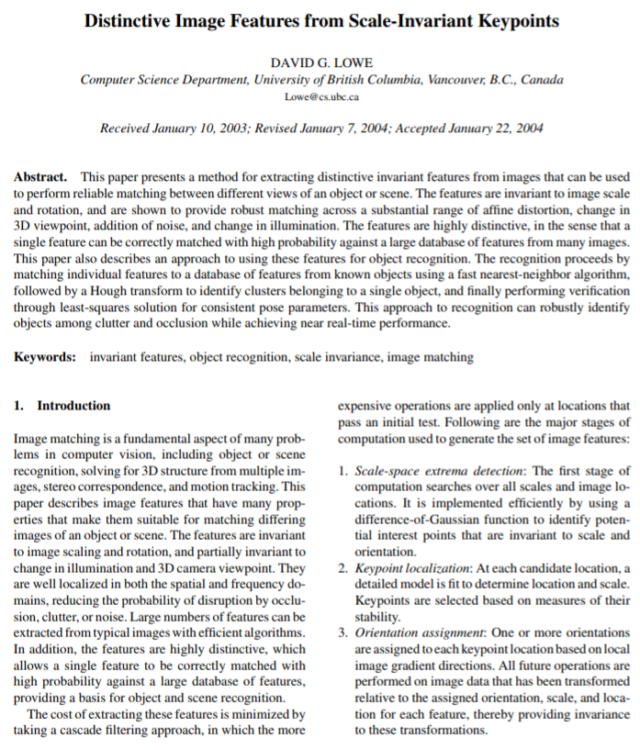
Citations: 48,781 as on 22-Oct-2018
International Journal of Computer Vision, 60(2), 91-110, 2004

Slide 8
SIFT – Key Point Extraction
Stands for Scale Invariant Feature Transform
Patented by university of British Columbia
Similar to the one used in primate visual system (human, ape, monkey, etc.)
Transforms image data into scale-invariant coordinates

Slide 9
Goal
Extract distinctive invariant features
Correctly matched against a large database of features from many images
Invariance to image scale and rotation
Robustness to
Affine (rotation, scale, shear) distortion,
Change in 3D viewpoint,
Addition of noise,
Change in illumination.

Slide 10
Advantages
Locality: features are local, so robust to occlusion and clutter
Distinctiveness: individual features can be matched to a large database of objects
Quantity: many features can be generated for even small objects
Efficiency: close to real-time performance

Slide 11
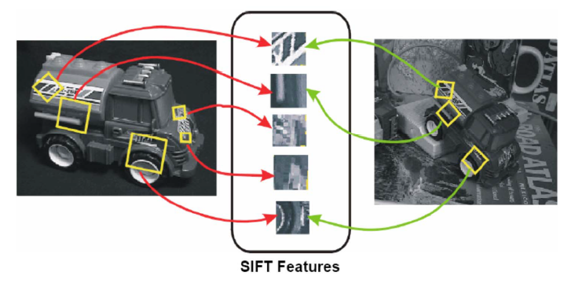
Invariant Local Features

Slide 12
Steps for Extracting Key Points (SIF Points)
Scale space peak selection
Potential locations for finding features
Key point localization
Accurately locating the feature key points
Orientation Assignment
Assigning orientation to the key points
Key point descriptor
Describing the key point as a high dimensional vector (128) (SIFT Descriptor)

Slide 13
Scales
What should be sigma value for Canny and LoG edge detection?
If use multiple sigma values (scales), how do you combine multiple edge maps?
Marr-Hildreth:
Spatial Coincidence assumption:
Zerocrossings that coincide over several scales are physically significant.

Slide 14
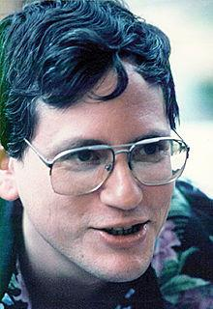

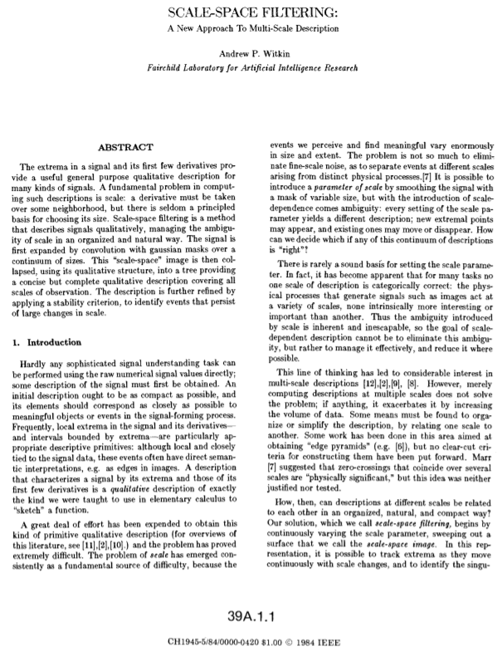
Andrew Witkin (July 22, 1952 – September 12, 2010)
Scale Space (Witkin, IJCAI 1983)

Slide 15
Scale Space (Witkin, IJCAI 1983)
Apply whole spectrum of scales (sigma in Gaussian)
Plot zero-crossings vs scales in a scale-space

Slide 16
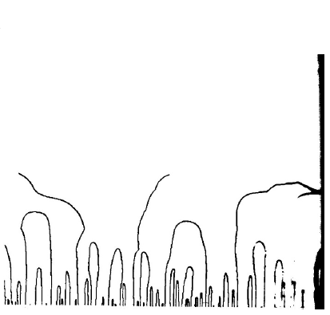
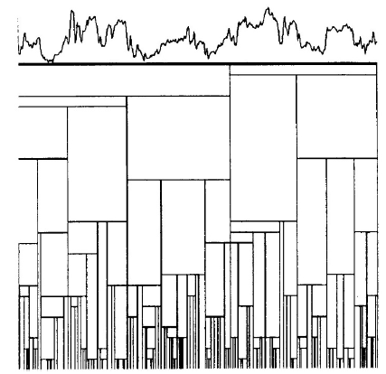
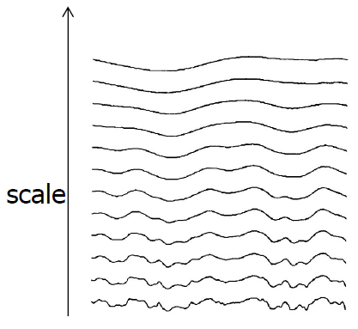
Scale Space
_{Multiple smooth}
_{versions of a signal}
Zero-crossings at multiple scales
_{Interval tree}

Slide 17
Scale Space (Witkin, IJCAI 1983)
Apply whole spectrum of scales
Plot zero-crossings vs scales in a scale-space
Interpret scale space contours
Contours are arches, open at the bottom, closed at the top
Interval tree
Each interval corresponds to a node in a tree,
whose parent node represents larger interval, from which interval emerged, and
whose off springs represent smaller intervals.
Stability of a node is a scale range over which the interval exits.

Slide 18
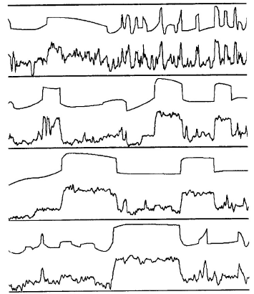
Scale Space
Top level description
Iteratively remove nodes from the tree,
splicing out nodes that are less stable than any of their parents and off springs
A top level description of several signals using stability criterion

Slide 19
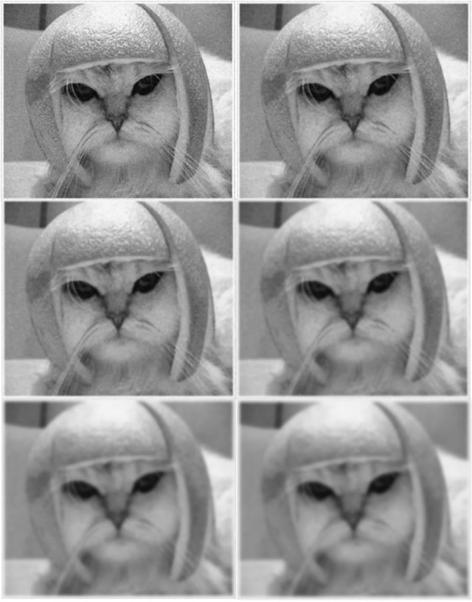
Scale Space
Real world objects are meaningful only at a certain scale.
Want to look at a leaf or the entire tree?
Use Gaussian Blur
Take an image and generate progressively blurred out images.

Slide 20
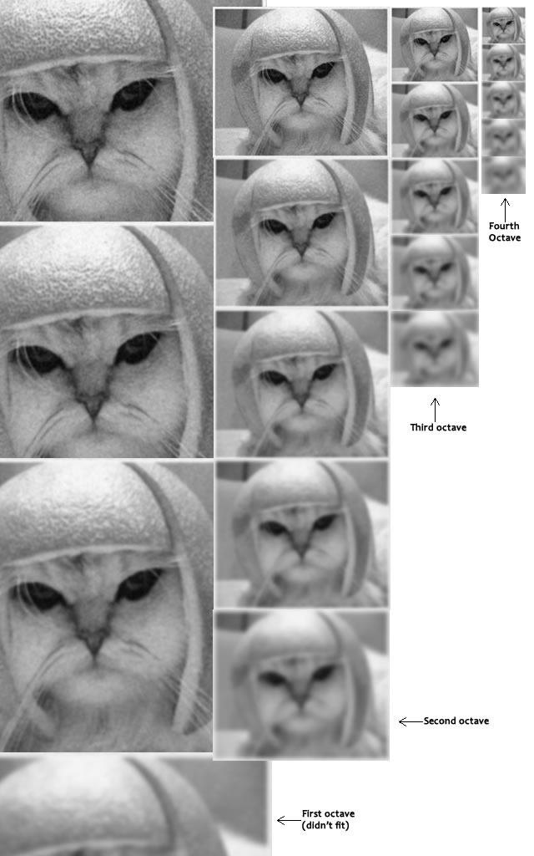
Scale Space in SIFT
Take an image, and generate progressively blurred out images.
Resize the image to half size.
Generate blurred out images again.
Keep repeating.
Images of the same size (vertical) form an octave.
See 4 octaves w/ 5 images.
Images are formed because of the increasing "scale".

Slide 21
Scale Space – Maths
Octaves and Scales
# of octaves and scale depends on the size of the original image.
4 octaves, 5 blur levels – SIFT Paper
The first octave
If the original image is doubled in size and antialiased a bit (by blurring it) then the algorithm produces more four times more keypoints.
More keypoints – better!

Slide 22
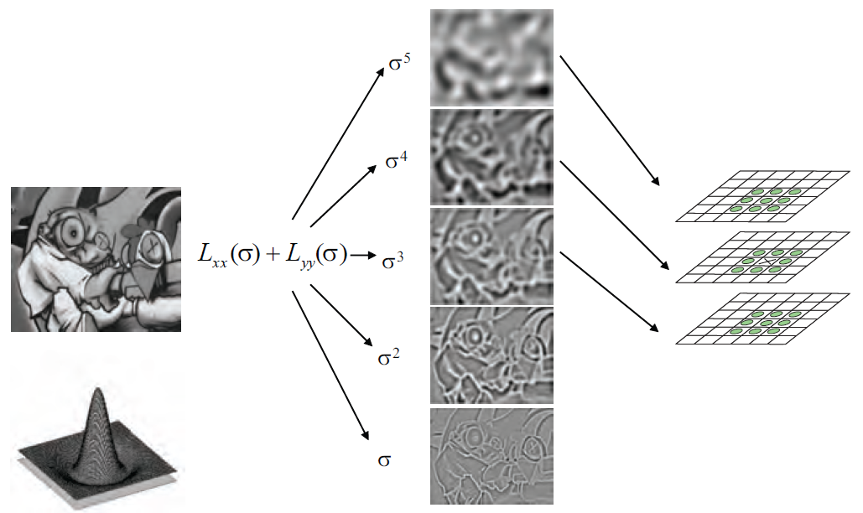
Laplacian of Gaussian (LoG)
Interest points:
Local maxima in scale space of Laplacian-of-Gaussian
_{Scale}

Slide 23
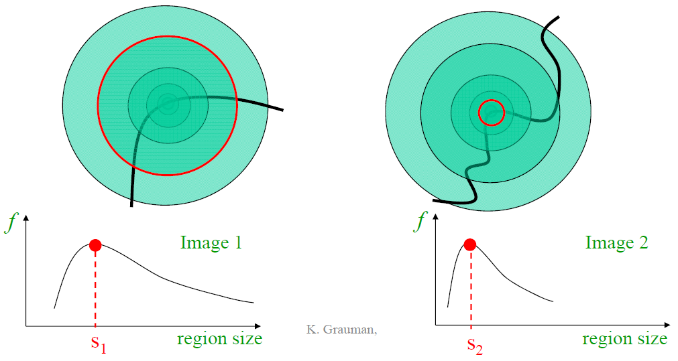
Automatic Scale Selection
Intuition: Find scale that gives local maxima of some function f in both position and scale.

Slide 24
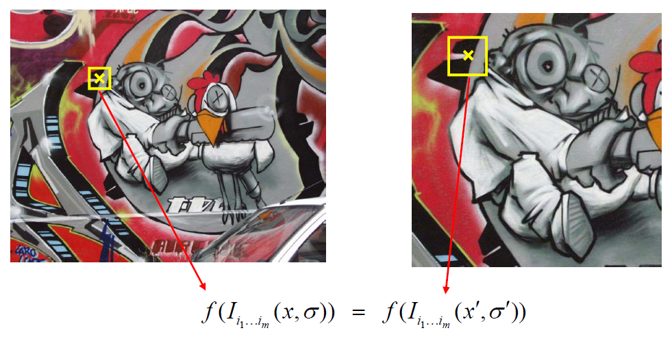
Automatic Scale Selection
Intuition: Find scale that gives local maxima of some function f in both position and scale.
How to find corresponding patch sizes?

Slide 25
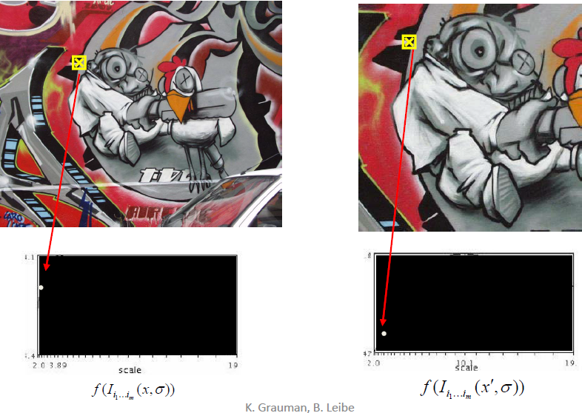
Automatic Scale Selection
Function responses for increasing scale (scale signature)

Slide 26

Automatic Scale Selection
Function responses for increasing scale (scale signature)

Slide 27

Automatic Scale Selection
Function responses for increasing scale (scale signature)

Slide 28

Automatic Scale Selection
Function responses for increasing scale (scale signature)

Slide 29
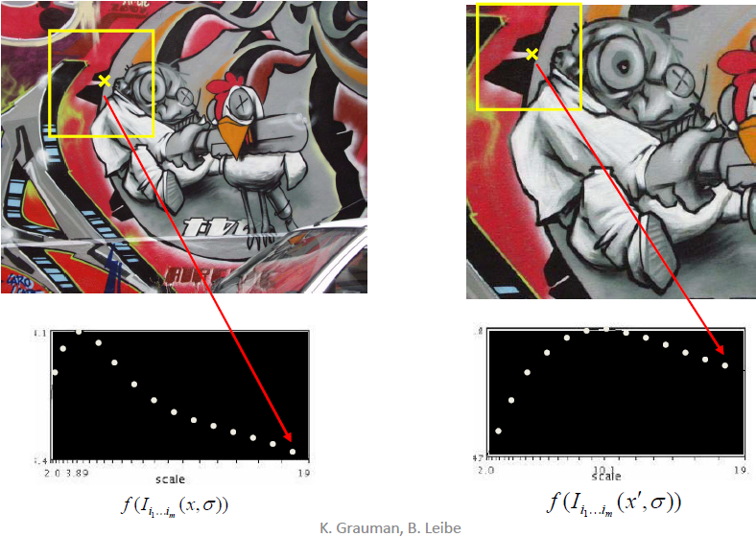
Automatic Scale Selection
Function responses for increasing scale (scale signature)

Slide 30
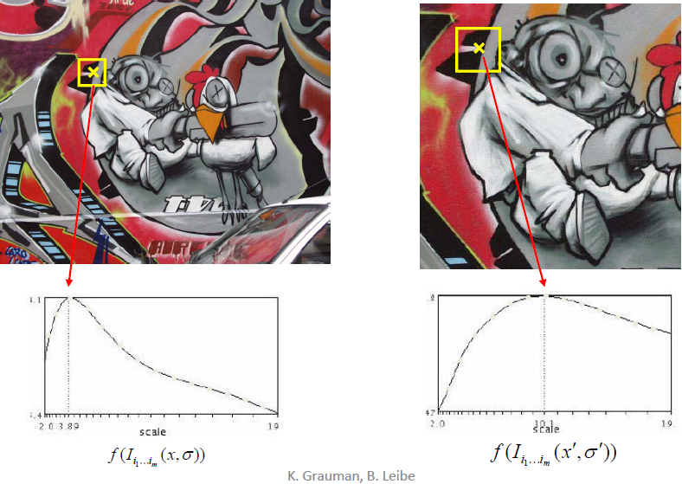
Automatic Scale Selection
Function responses for increasing scale (scale signature)

Slide 31
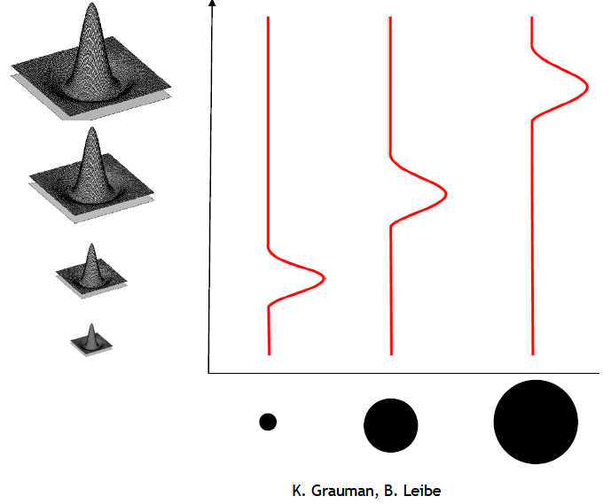
What is a useful signature function?
Laplacian-of-Gaussian = “blob” detector
Using Mexican Hat – Negative of LoG
Note: We are using max of LoG (blob detection) – not the zero-crossing (edges)

Slide 32
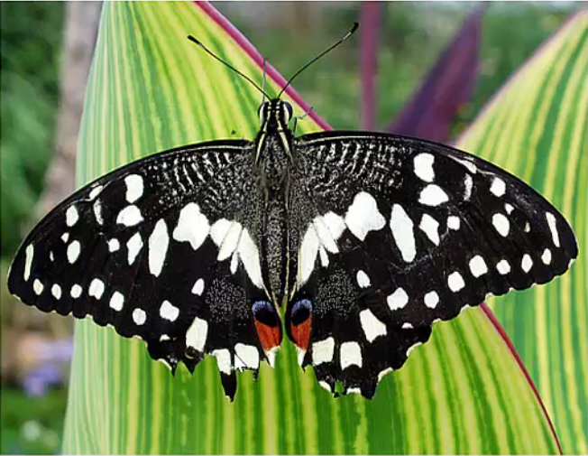
Scale Space Blob Detector: Example

Slide 33
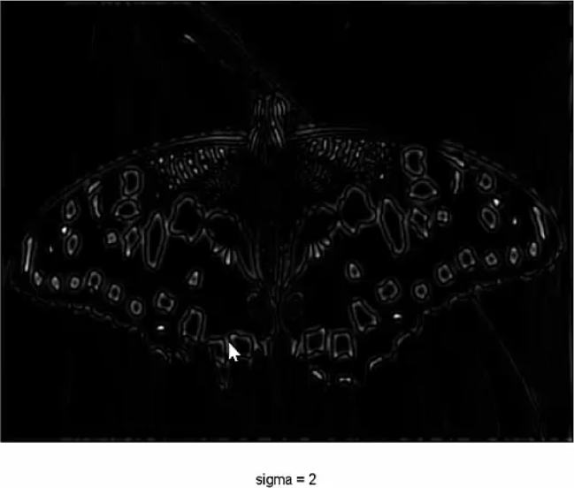
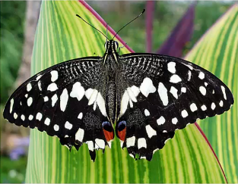
Scale Space Blob Detector: Example

Slide 34
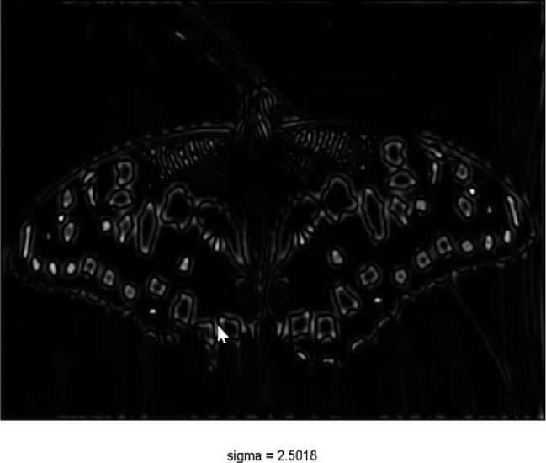
Scale Space Blob Detector: Example

Slide 35
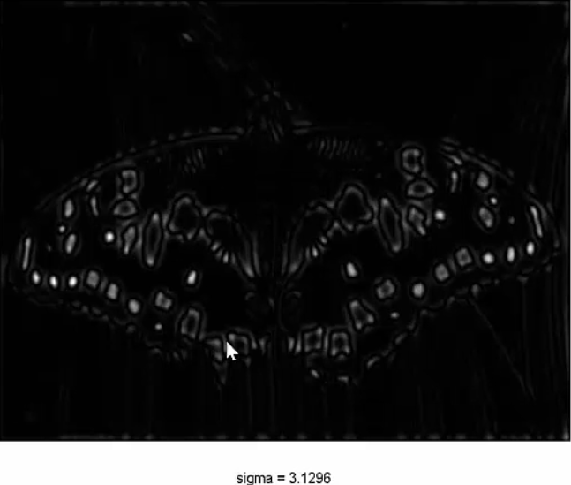
Scale Space Blob Detector: Example

Slide 36
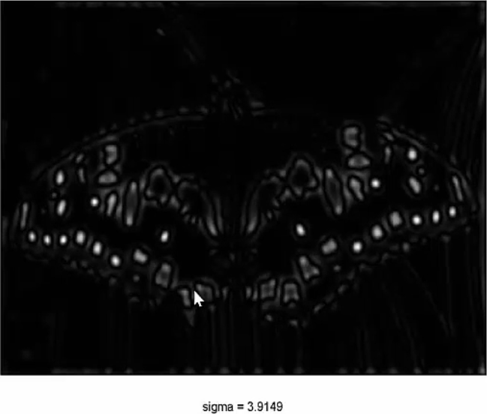
Scale Space Blob Detector: Example

Slide 37
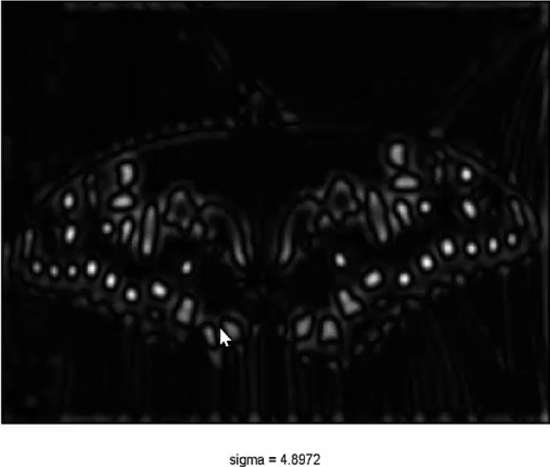
Scale Space Blob Detector: Example

Slide 38
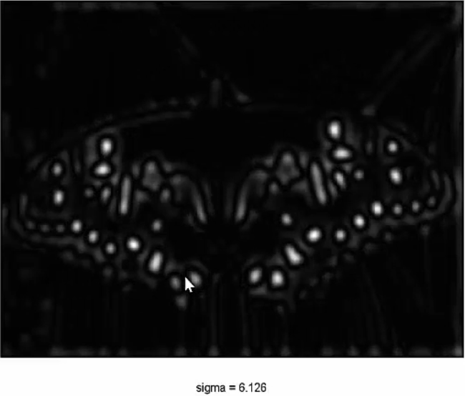
Scale Space Blob Detector: Example

Slide 39
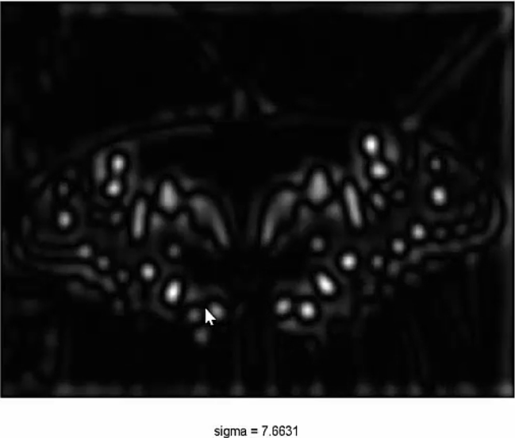
Scale Space Blob Detector: Example

Slide 40
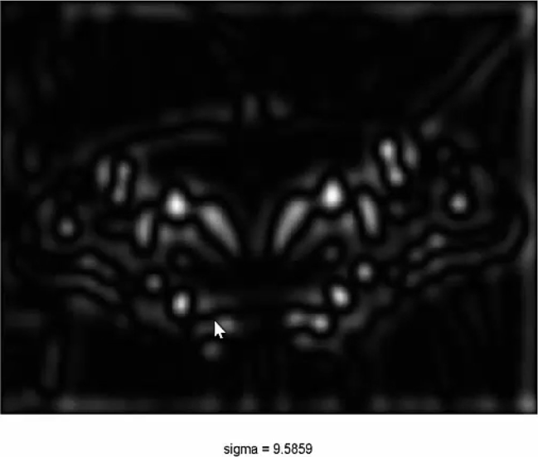
Scale Space Blob Detector: Example

Slide 41
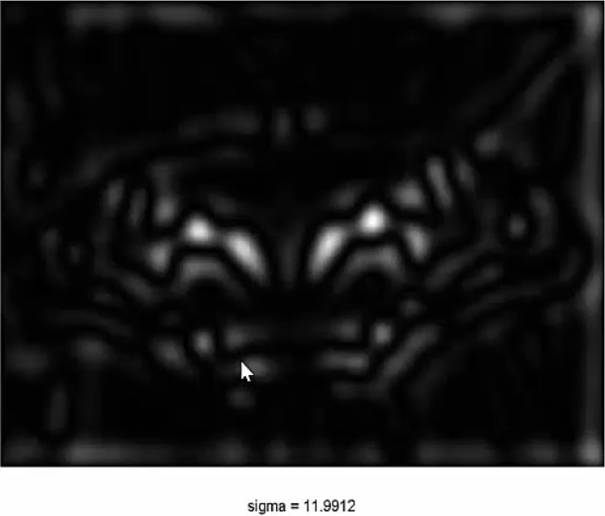
Scale Space Blob Detector: Example

Slide 42
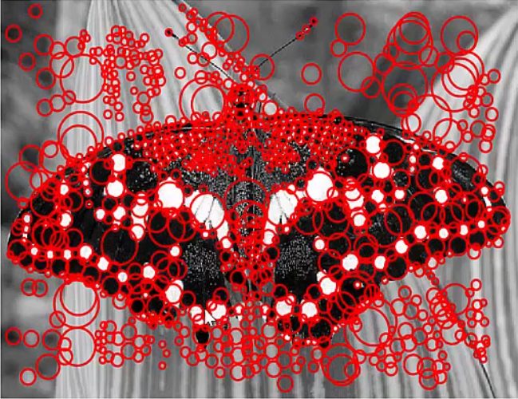
Scale Space Blob Detector: Example
Max responses shown with circles having radius of scale

Slide 43
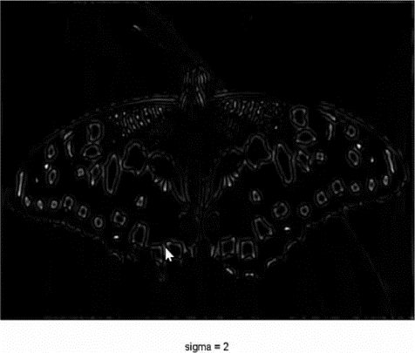

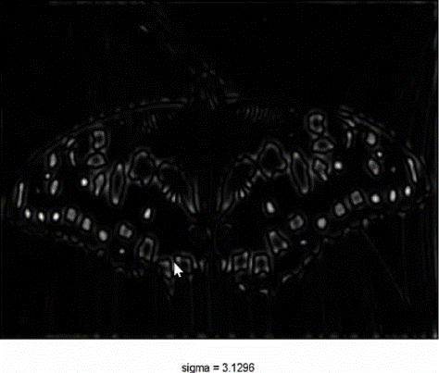
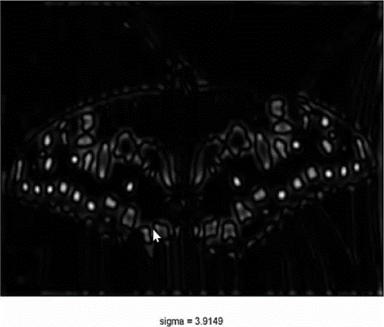
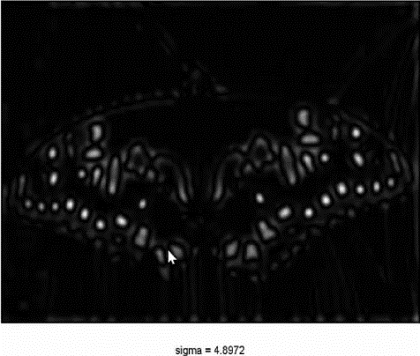


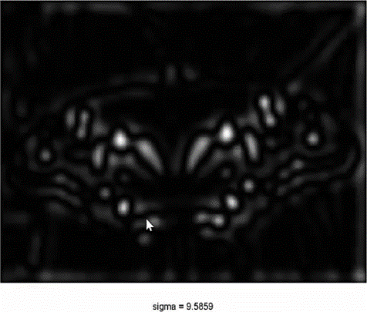
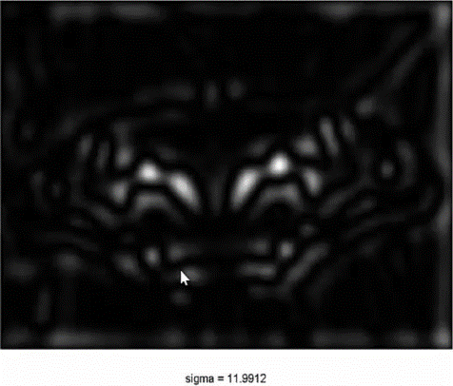
Scale Space Blob Detector: Example

Slide 44
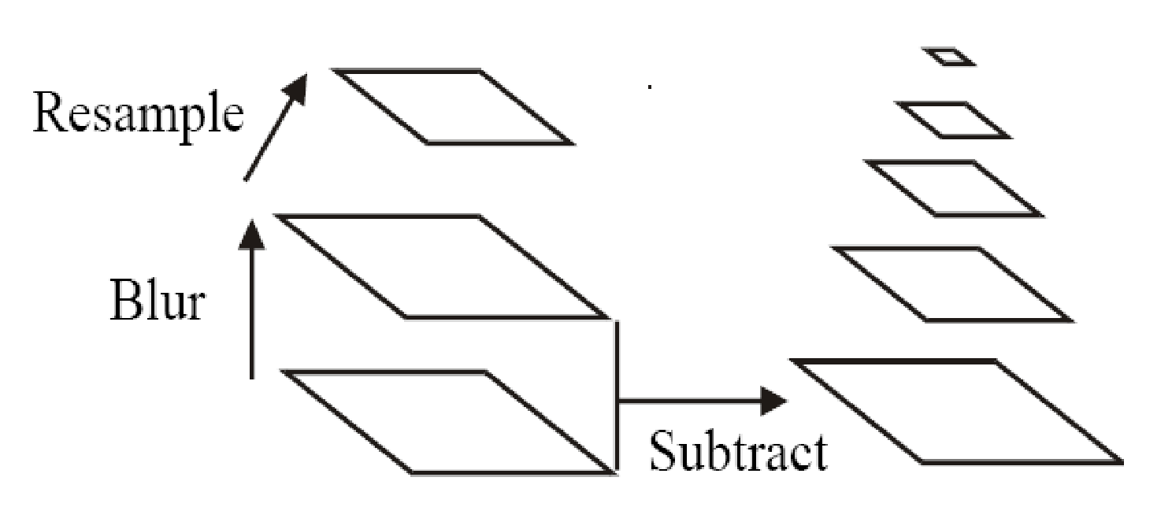
Building Scale Space
All scales must be examined to identify scale-invariant features
An efficient function is to compute the Laplacian Pyramid (Difference of Gaussian) (Burt & Adelson, 1983)

Slide 45
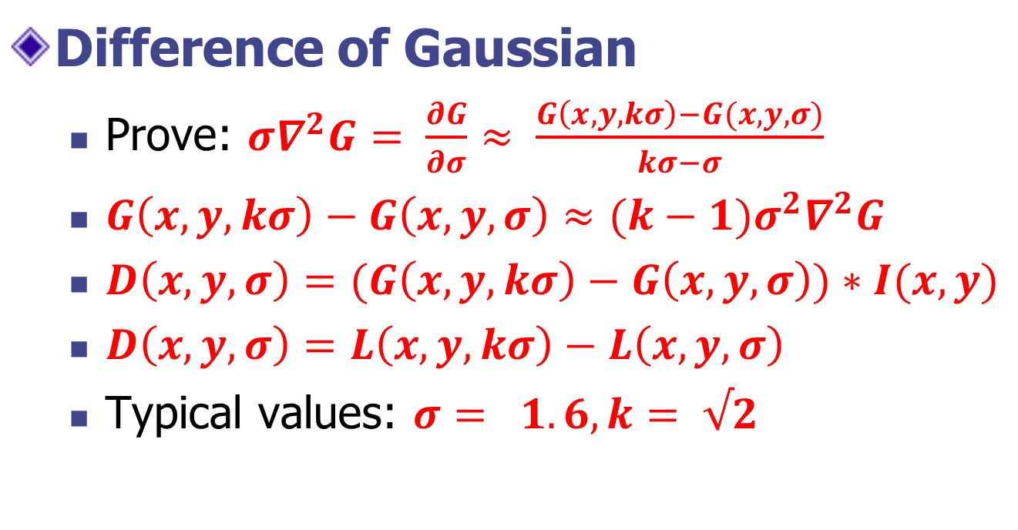
Approximation of LoG by Difference of Gaussians

Slide 46
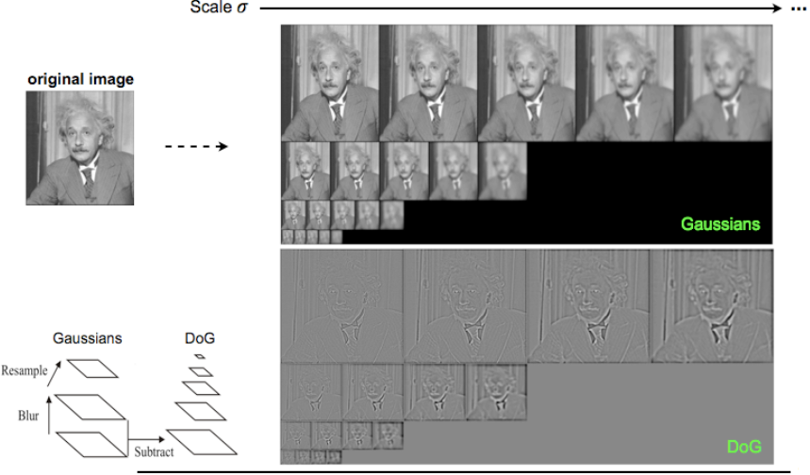

Slide 47
Steps for Extracting Key Points (SIF Points)
Scale space peak selection
Potential locations for finding features
Key point localization
Accurately locating the feature key points
Orientation Assignment
Assigning orientation to the key points
Key point descriptor
Describing the key point as a high dimensional vector (128) (SIFT Descriptor)

Slide 48
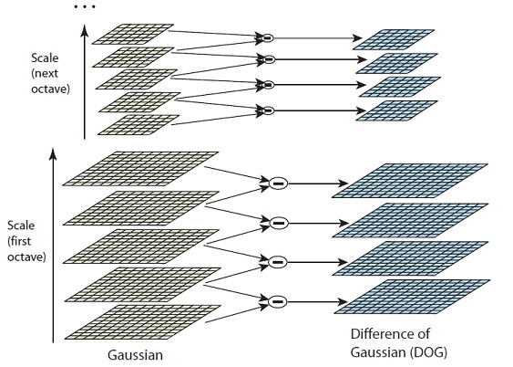
Building Scale Space

Slide 49
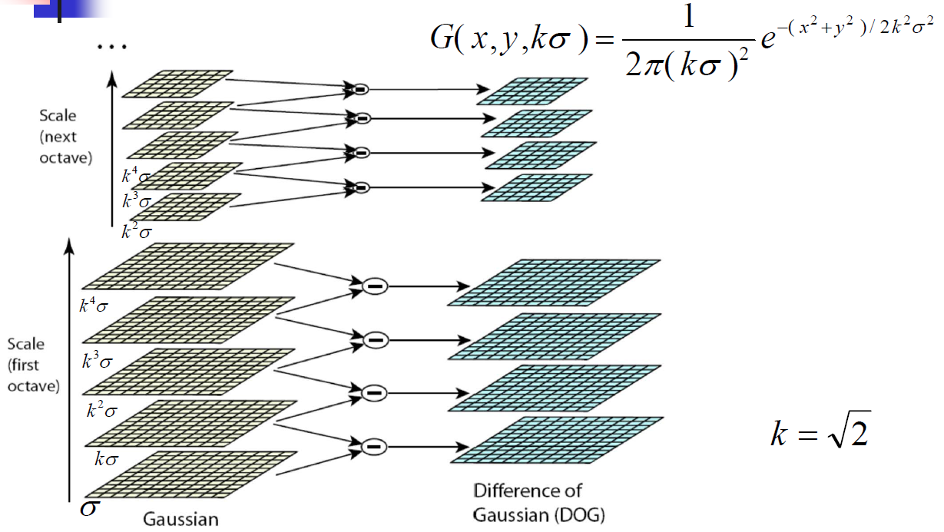
Building Scale Space

Slide 50
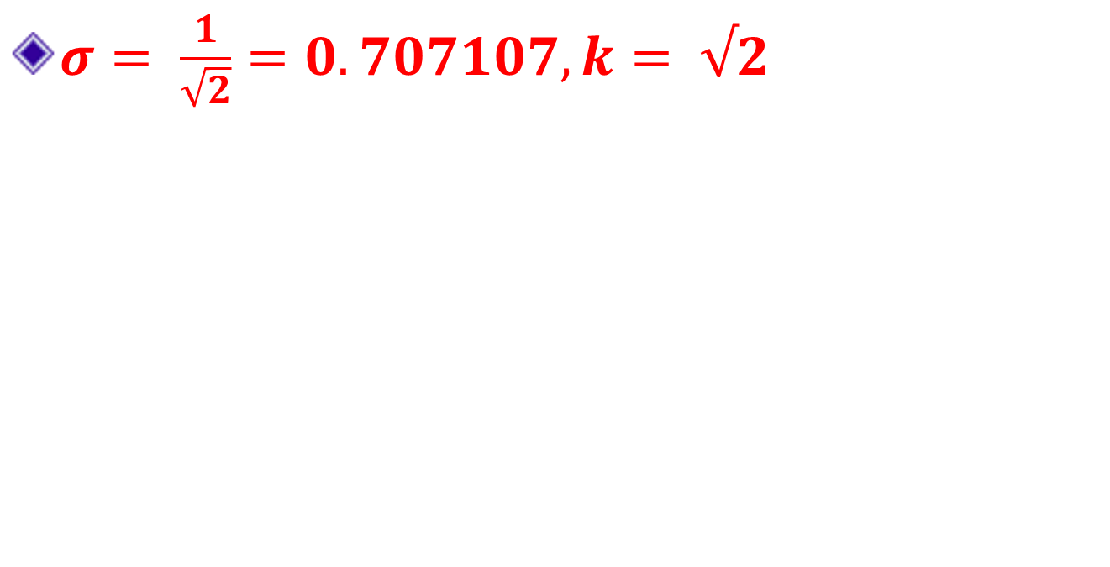
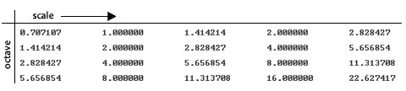
Scale / Octave

Slide 51
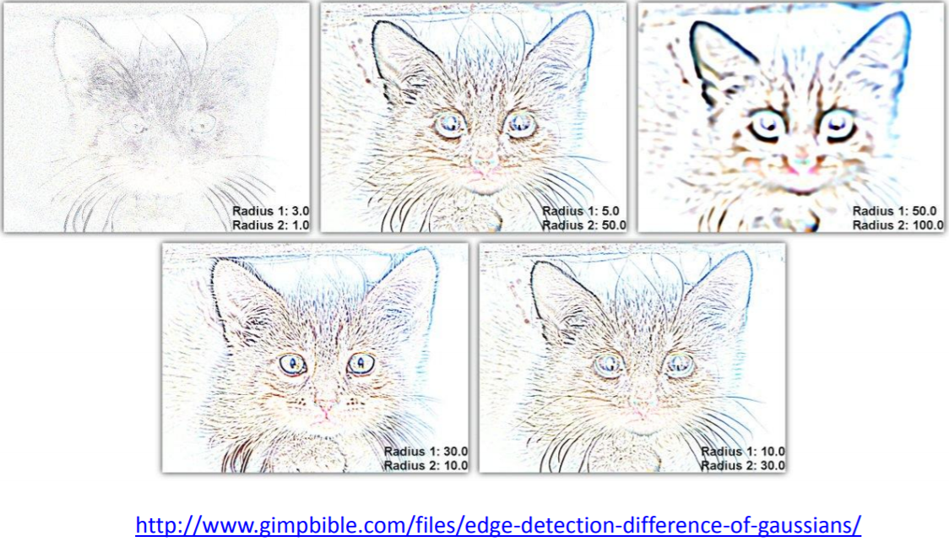
_{Cat DoG}
This is an example of the DoG filter in gimp. In SIFT, however, the DoG is computed from Gaussians at nearby scales.

Slide 52


_{Approximate Keypoint Location}
Source: https://docs.gimp.org/en/plug-in-dog.html

Slide 53
How many scales per octave?
A collection of 32 real images drawn from a diverse range, including
outdoor scenes, human faces, aerial photographs, and industrial
Each image was then subject to a range of transformations:
rotation, scaling, affine stretch, change in brightness and
contrast, and addition of image noise.

Slide 54

How many scales per octave?
_{3 Scales}

Slide 55

Initial value of sigma
_{Sigma = 1.6}

Slide 56
Steps for Extracting Key Points (SIF Points)
Scale space peak selection
Potential locations for finding features
Key point localization
Accurately locating the feature key points
Orientation Assignment
Assigning orientation to the key points
Key point descriptor
Describing the key point as a high dimensional vector (128) (SIFT Descriptor)

Slide 57

Scale Space Peak Detection
Compare a pixel (X) with 26 pixels in current and adjacent scales (Green Circles)
Select a pixel (X) if larger / smaller than all 26 pixels
Large number of extrema, computationally expensive
Detect the most stable subset with a coarse sampling of scales

Slide 58


Key Point Localization
Candidates are chosen from extrema detection
_{Original Image}
_{Extrema Locations}

Slide 59

Key Point Localization
Initial Detection of Keypoints (by thresholding determinant of Hessian matrix)

Slide 60

Refine Key Point Localization
We now have, the approximate maxima and minima.
They are "approximate" because the maxima/minima almost never lies exactly on a pixel. It lies somewhere between the pixel.
So, we mathematically locate the subpixel location.
The red crosses mark pixels in the image. But the actual extreme point is the green one.
Use
Taylor Series Expansion or
Bilinear Interpolation

